Slide 1
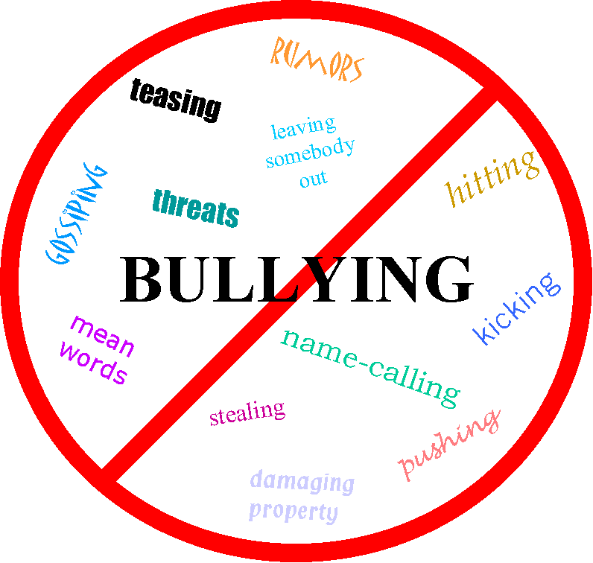
Bullying
Bullying is when someone uses force, superior strength or influence to intimidate another person for self gratification

Slide 2
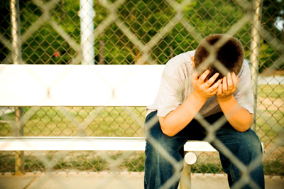
There are many types of bullying. All of them can be harmful to anyone.

Slide 3
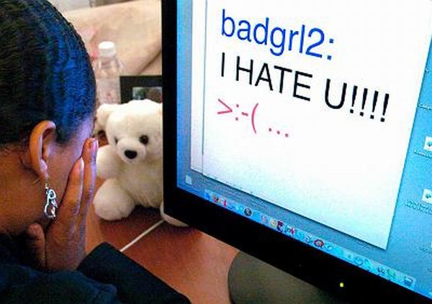
Cyber Bullying
Cyber Bullying is when someone hurts another person through electronical means.
Such devices include computers, phones, tablets, ipads, and music players with internet or mailing service.

Slide 4
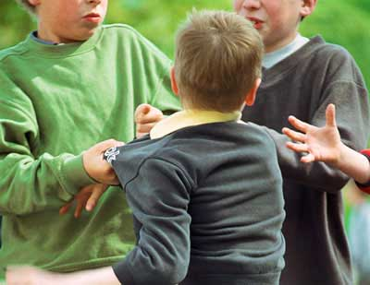
Physical Bullying
Physical Bullying is when someone physically hurts or intimidates another.
This is probably the most well known type of bullying, seen in many forms of media, such as television.

Slide 5
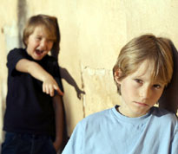
Mental Bullying
Mental Bullying is when someone verbally hurts another through name calling and nasty vibes.

Slide 6
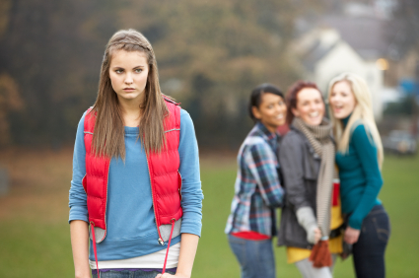
Social Bullying
Social Bullying is when someone spreads rumors, excludes, or embarrasses another.

Slide 7
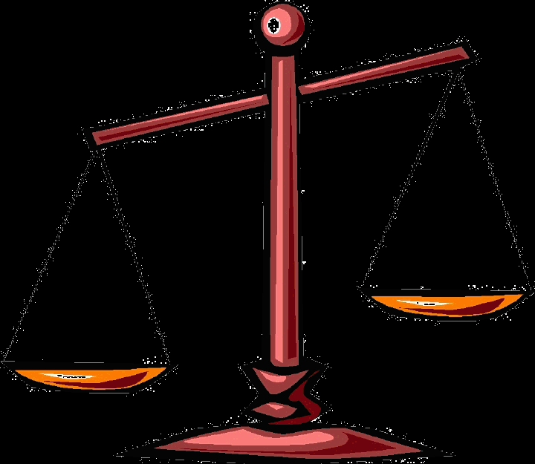
Social vs. Mental
Social and Mental Bullying are very similar but very different.
Social normally involves secrecy, excluding and talking behind ones back, while Mental typically involves face-to-face verbal insults and embarrassment.

Slide 8
Prevention
Bullying has become a major issue and can lead to suicide and depression.
Many celebrities, companies, and ordinary people are taking action to stop bullying before it is to late.
Bullies have already caused multiple catastrophes across the nation and needs to end now.

Slide 9
Credits and Biography
This presentation was made possible through Microsoft PowerPoint and Google search engine.
Photos and Information provided by Google
Google is a search

